Slide 1
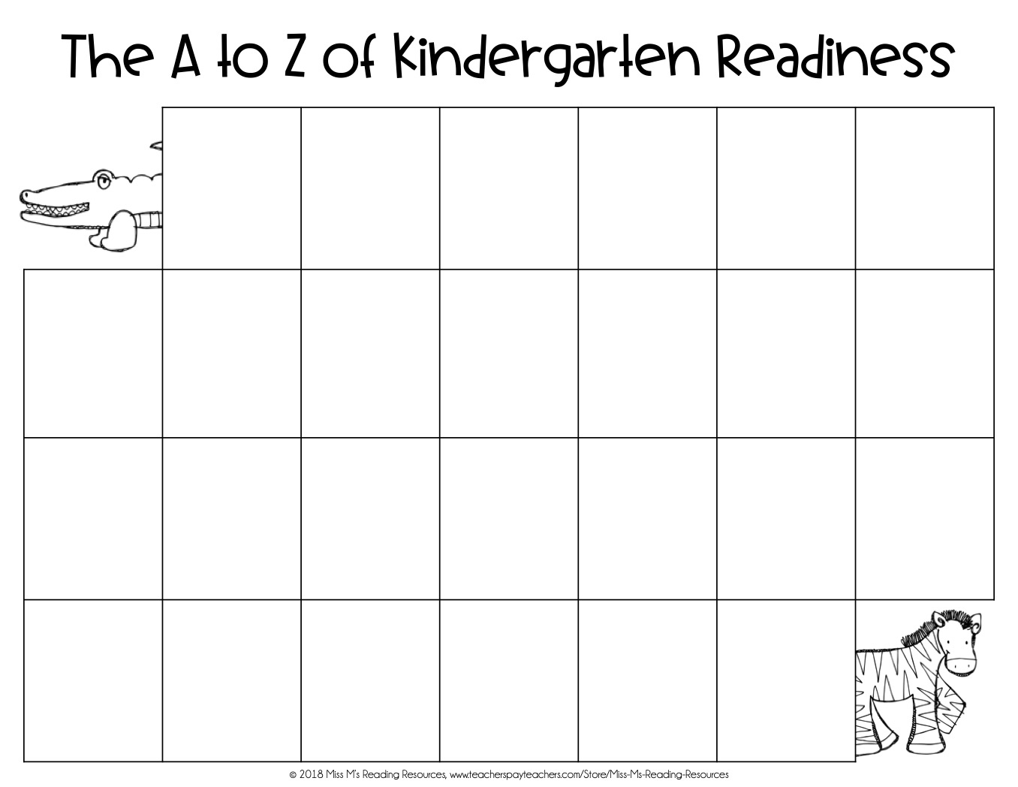


FUTURE RANCHER KINDERGARTEN READINESS
We will meet your child where he/she is at!
 | ABCs & 123s: Recognize & Write numbers 0-10, Say, Write, & Recognize ABCs, and be introduced to the sounds they make | Bathroom: Use the bathroom & put clothes back on independently | Cut, Color, & Glue: Can use scissors, glue sticks, and crayons | Shapes: Be able to recognize basic shapes including square, circle, Triangle | Enjoys Learning: Excited to learn new things & become the next Rancher | Fail friendly: Can adjust to setbacks and try again
Get Dressed: Can put on & take off clothes independently | Handwriting: Holds pencil/crayon with a non-fisted grip and always write from the top to the bottom | Independence: Can problem-solve with assistance & not lose emotional control | Jump & Play: Ready for recess in many seasonal weather conditions | Kind: Is kind to others, can interact with classmates in a positive way, and share | Lunch: Can open & close food packaging & eat independently using utensils | Minutes: Can focus on an adult-directed task for 5-15 minutes
Name: Can recognize and write name starting with a capital letter | Observative: Curious about what’s around them & willing to ask/answer questions about what they see/hear | Puzzles: Puzzles build fine motor and spatial skills, problem-solving skills, and perseverance | Quiet Listener: Can listen quietly and self regulate for 5-15 minutes | Ready to Read: Can hold a book & track words or follow along & answer questions about what was read | Shoes: We will work on tying shoes, but it is an evolving task. If your child does not know how to tie their shoes, please send them with non tying shoes. | Trace: Can trace straight and curved lines
Understand Directions: Can follow 1-3 step directions | Voice: Can control voice level in different settings | Wait & Walk In Line: Can wait patiently in a line | Colors: Can name and recognize primary colors. | Yearly Calendar: Can recognize birthday month & day. Be ready to meet for morning calendar | Zippers, etc.: Can use zippers & buttons on clothes
This Checklist is intended to ease your student’s transition & let parents know what their child should know entering kinder.

