Slide 1
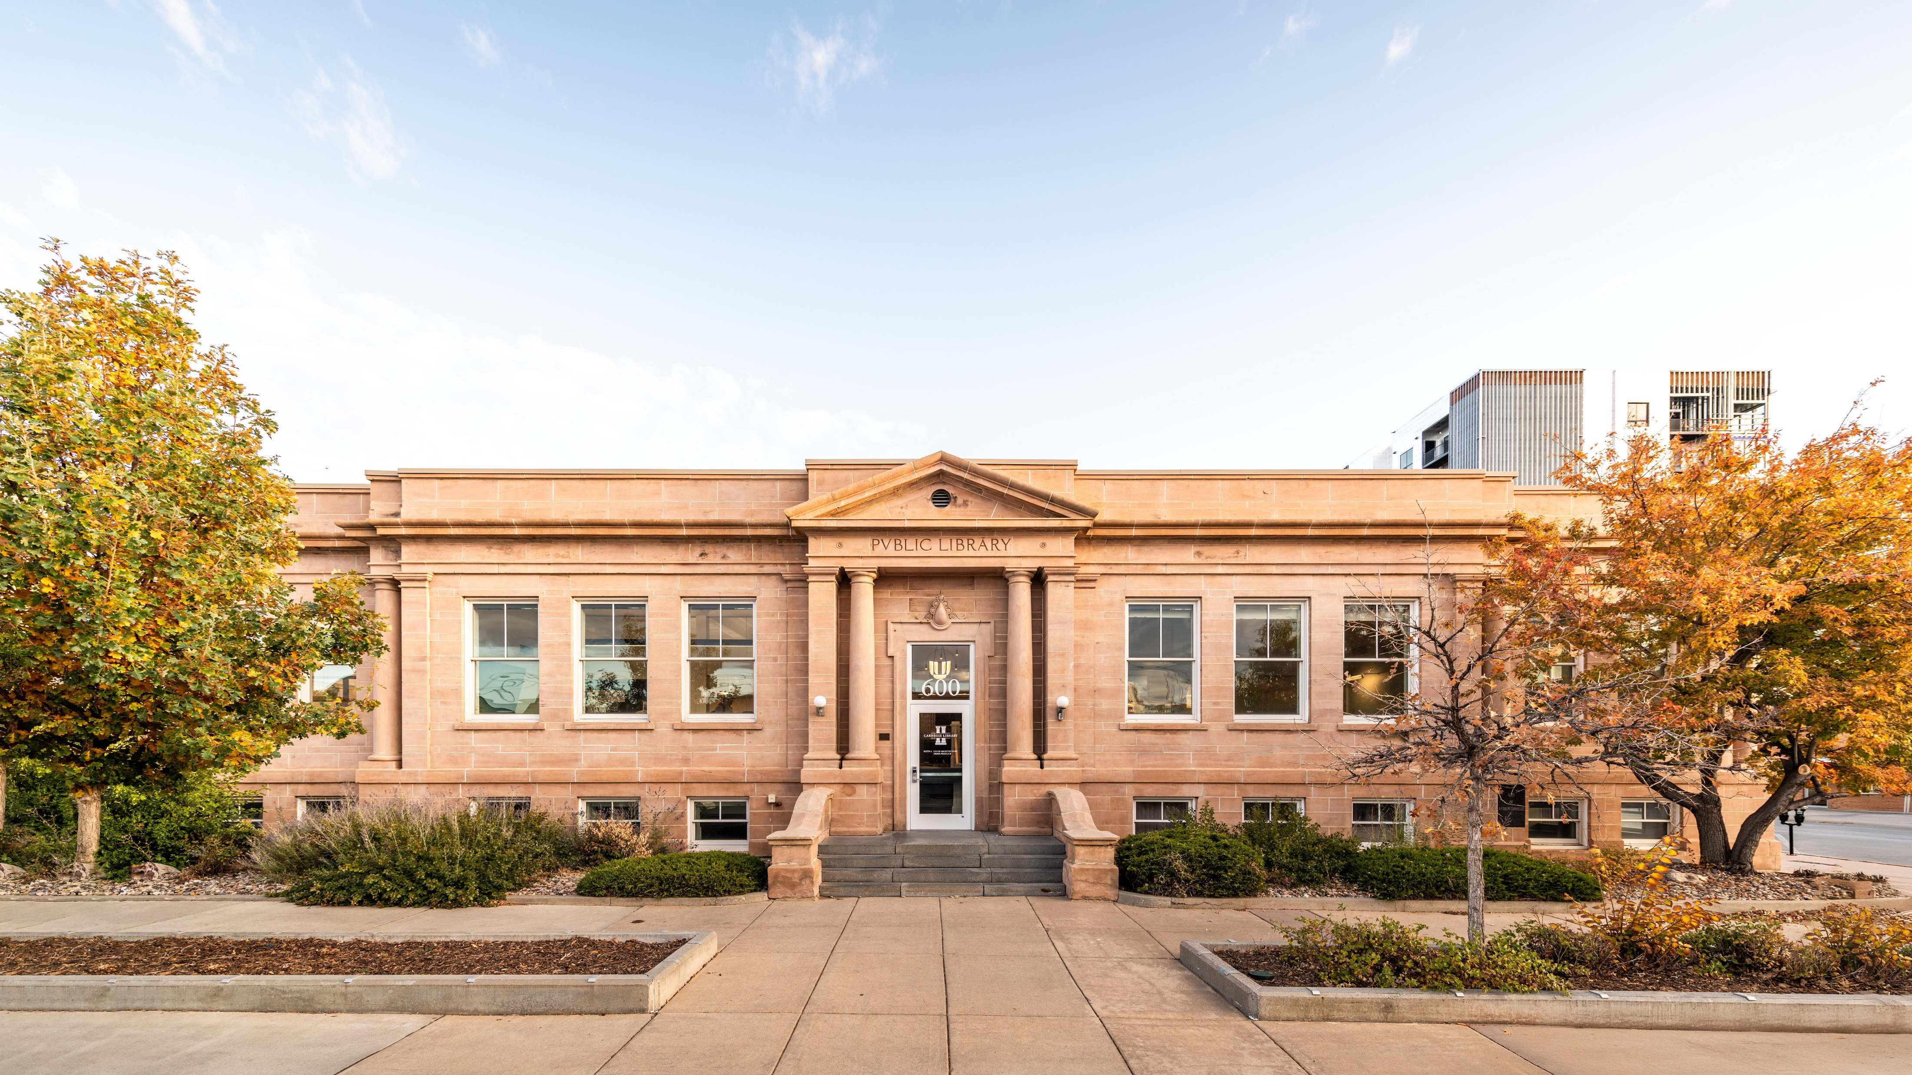
ABOUT US – CO-OP Architecture
CO-OP ARCHITECTURE | Harding County School District
Notes:
Born in 2012, CO-OP Architecture is a 32.25-person design firm with offices in Rapid City, Sioux Falls and Aberdeen, South Dakota, plus our newest in Sioux Center, IA.
The name CO-OP is a nod to the cooperation that underpins life in the heartland. We believe it’s our responsibility to make life better in our communities and that the best design solutions are the product of collaboration -- with clients, consultants, contractors and coworkers.
We want to surprise our collaborators with our thoughtfulness, effort and enthusiasm.
We want better architecture in our own backyard.
Feel free to visit co-oparch.com to learn more about our team and some of our work.
Red #c02025 | Blue #074e9c | Gold #dc9c26 | Grey #9c9d9b

Slide 2

WHO WE ARE
See what we’re up to!
30.25 PERSON DESIGN FIRM
co-oparch.com
2024 AIA, SD | Merit Award (Railyard Flats)
2023 AIA, SD | Honor Award (Click Rain & Lemonly Headquarters) |Honor Award (Watertown Regional Airport)
2022 AIA, SD | Merit Award (Friends & Citizens)
2021 AIA, SD | Merit Award (NSU Regional Sports Complex)
2020 AIA, SD | Merit Award (Britton Event Center) | Merit Award (Look’s Marketplace)
2019 AIA, SD | Merit Award (NSU Athletic Pavilion)
2017 AIA, SD | Honor Award (Aberdeen KO Lee Public Library) | People’s Choice (Aberdeen KO Lee Public Library)
Merit Award (Minn. & St Louis Depot)
CO-OP ARCHITECTURE | Harding County School District

Slide 3
WHAT WE DO
FACILITIES ASSESMENT
FACILITIES PLANNING
ENROLLMENT
+ CAPACITY
LIFE CYCLE COSTS
BOND ASSISTANCE
BUDGET REVIEW
FACILITY DESIGN
CONSTRUCTION ADMINISTRATION
CO-OP ARCHITECTURE | Harding County School District

Slide 4

WHERE WE’VE BEEN
EDUCATION PROJECTS
1. ABO School District - Agar, Blunt & Onida, SD‡
2. Alcester-Hudson School District - Alcester, SD‡
^{3. ATEC Academy - Aberdeen, SD}
4. Belle Fourche School District - Belle Fourche, SD*
5. Black Hills State University - Spearfish, SD*
6. Burke School District - Burke, SD
7. Canistota School District - Canistota, SD‡
8. CC Lee Elementary School - Aberdeen, SD
9. Christ the King Elementary School - Sioux Falls, SD
10. Custer School District - Custer & Hermosa, SD
11. De Smet Elementary School - De Smet, SD
12. Deubrook Schools - Deubrook, SD
13. Deuel School District - Clear Lake, SD
14. Douglas School District - Box Elder, SD‡
15. Dupree School District - Dupree, SD‡
16. Elkton Public School - Elkton, SD
17. Ellendale Public School - Ellendale, ND
18. Ethan School District - Ethan, SD
19. Faulkton Area Schools - Faulkton, SD*
20. Freeman Jr.-Sr. High School - Freeman, SD
21. Garretson High School - Garretson, SD
22. Gregory School District - Gregory, SD
23. Hamlin School District - Hayti, SD
24. Hermosa School District - Hermosa, SD*
25. Hitchcock-Tulare Middle-High School - Tulare, SD
26. Holgate Junior High School - Aberdeen, SD
27. Hoven High School - Hoven, SD
28. Lake Area Technical College - Watertown, SD‡
29. Langford Public School - Langford, SD
30. Lemmon School District - Lemmon, SD
31. Lincoln Elementary School - Aberdeen, SD
32. Marion Public School District - Marion, SD*
33. McLaughlin School - McLaughlin, SD
34. McIntosh School - McIntosh, SD
35. Mike Miller Elementary School - Aberdeen, SD
36. Milbank Elementary School - Milbank, SD
37. Mount Marty University - Yankton, SD‡
38. Northern State University - Aberdeen, SD‡
39. Northwestern School District - Mellette, SD
40. Okoboji Community Schools - Milford, IA
41. Oldham-Ramona-Rutland - Ramona, SD
42. Oglala Lakota County School District - Batesland, SD‡
43. O.M. Tiffany Elementary School - Aberdeen, SD
44. Pope Pius XII Newman Center - Brookings, SD*
45. Presentation College - Aberdeen, SD‡
46. Rapid City School District - Rapid City, SD‡
47. Roncalli High School - Aberdeen, SD
48. Russell Tyler Ruthton Public School - Tyler, MN
49. St. Thomas More School - Brookings, SD*
50. Simmons Middle School - Aberdeen, SD
51. Sisseton School District - Sisseton, SD‡
52. Sioux Valley Elementary School - Volga, SD
53. South Dakota Mines - Rapid City, SD‡
54. South Dakota State University - Brookings, SD‡
55. South O’Brien Community School District - Paullina, IA
56. Southwest MN Christian Schools - Edgerton, MN*
57. Tri-Valley School District - Crooks, SD
58. Viborg-Hurley Public School - Hurley & Viborg, SD
59. Watertown High School - Watertown, SD‡
60. West Central School District - Hartford & Humboldt, SD‡
61. West Lyon Community School District - Inwood, IA‡
62. White River School District - White River, SD*
63. Willow Lake School District - Willow Lake, SD‡
64. Wounded Knee School District - Porcupine, SD‡
‡ Project(s) + Facilities Plan * Facilities Plan
60+
SCHOOL
PROJECTS
Harding County School District
CO-OP Architecture’s K-12 School Projects
CO-OP Architecture’s Office Locations
CO-OP ARCHITECTURE | Hot Springs School District

Slide 5
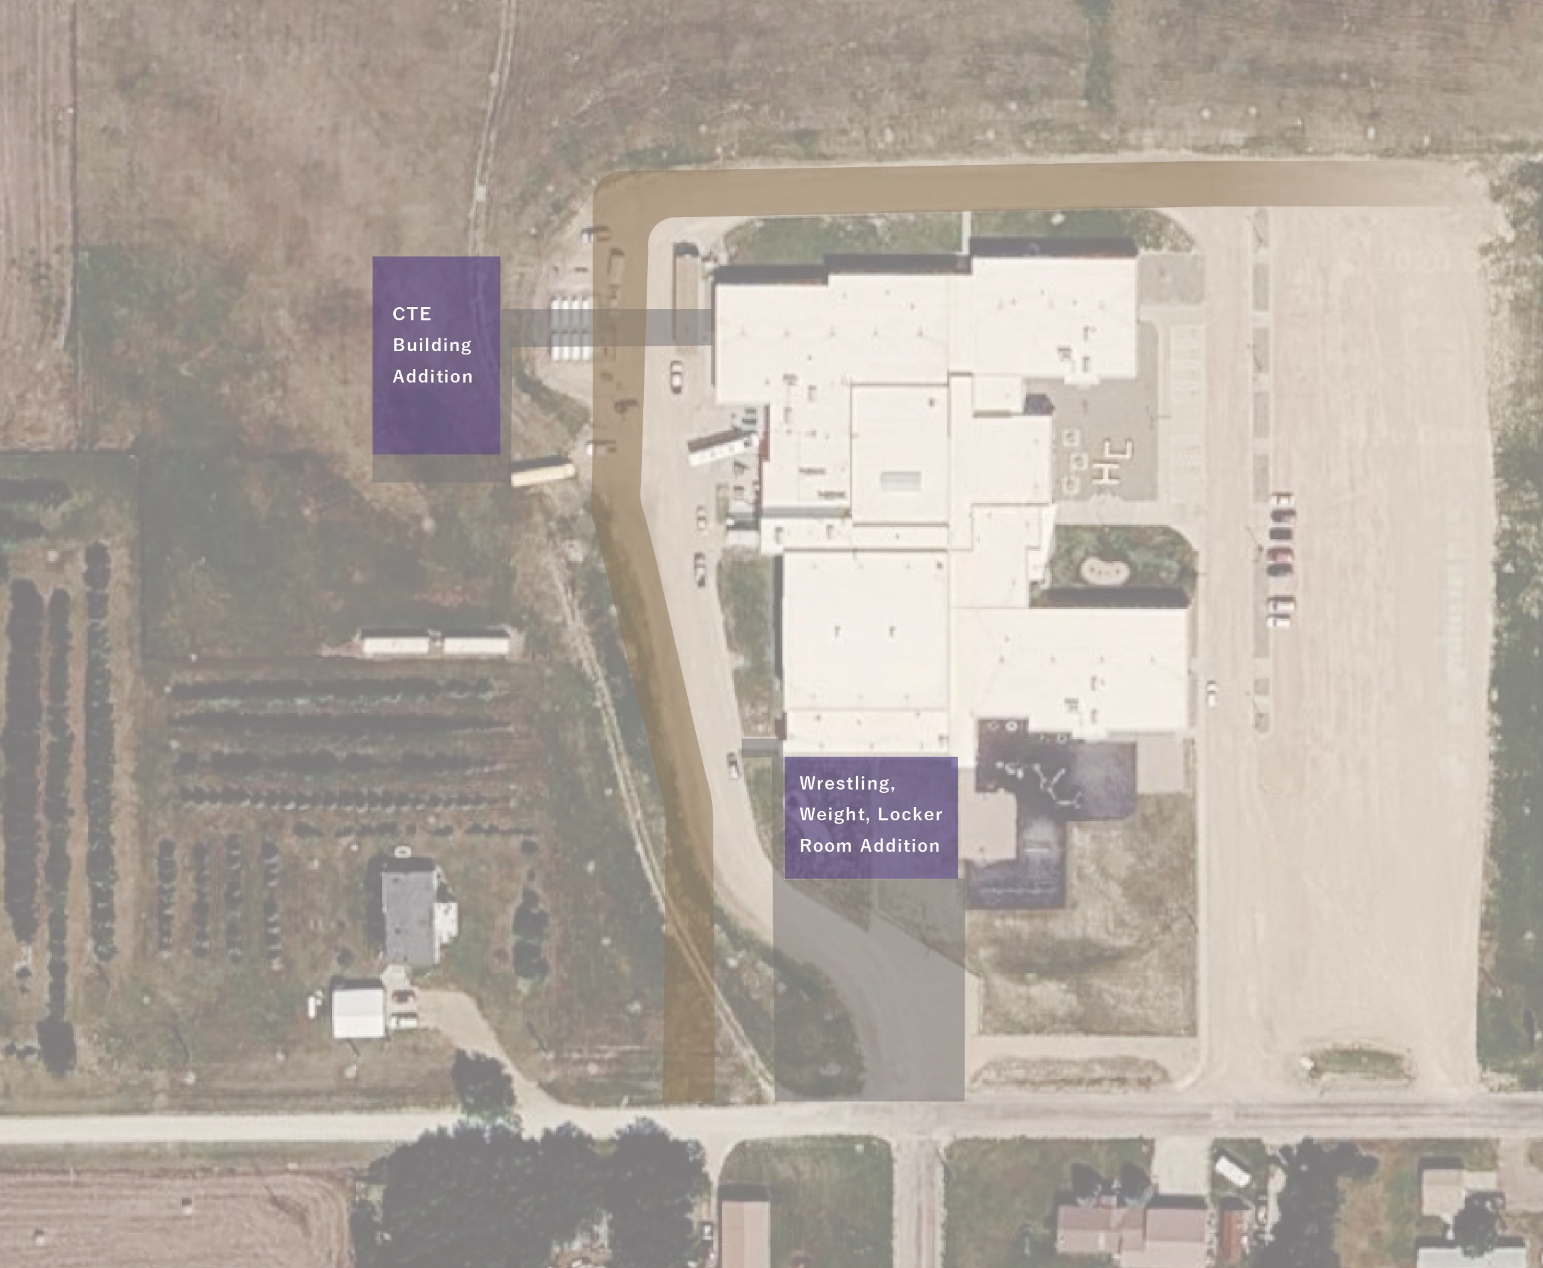
Harding County School Additions
CO-OP ARCHITECTURE | Harding County School District

Slide 6
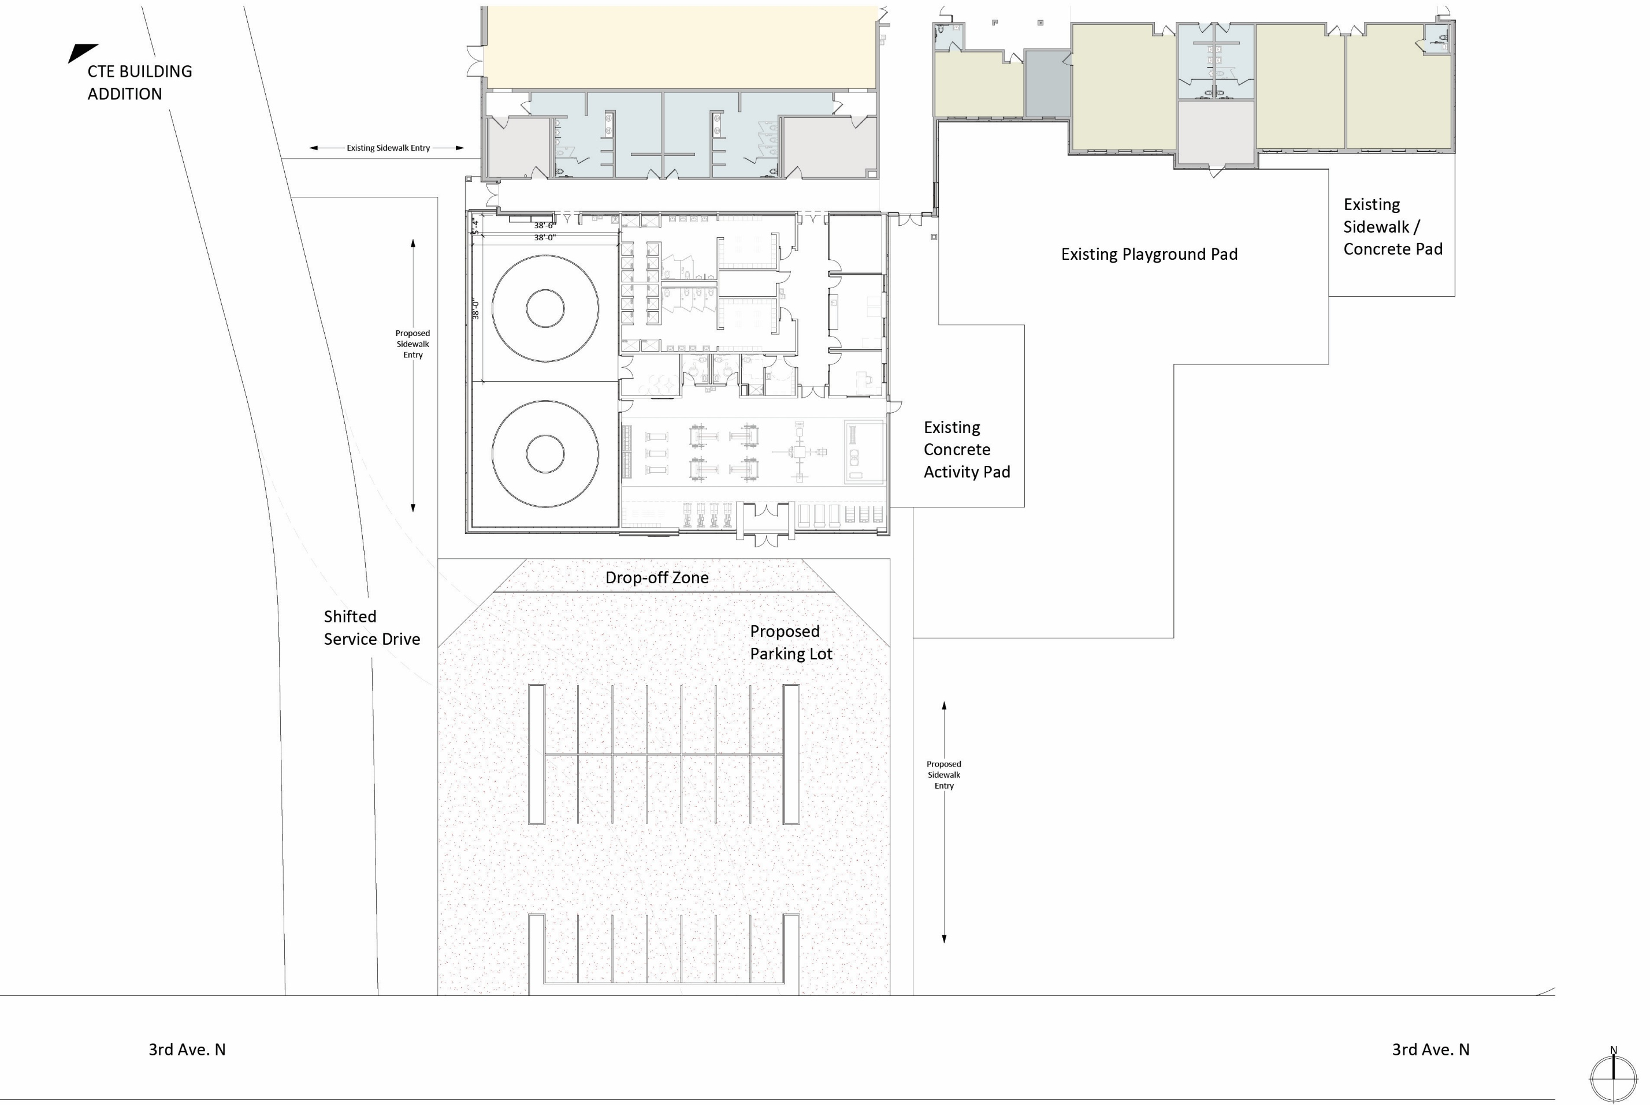
Multi-Purpose Weight Room Locker Room
Addition
9350 SF
CO-OP ARCHITECTURE | Harding County School District

Slide 7
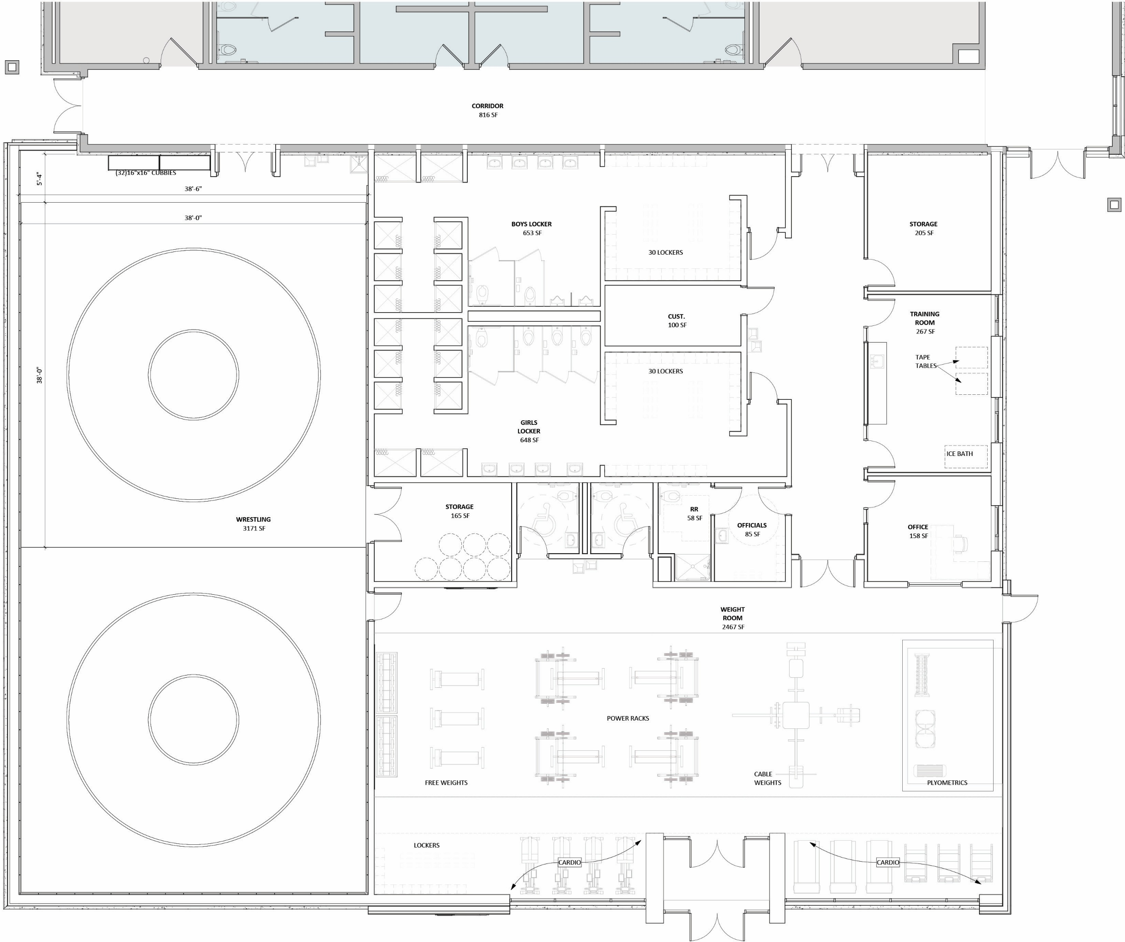

Multi-Purpose Weight Room Locker Room
Addition
9350 SF
CO-OP ARCHITECTURE | Harding County School District

Slide 8
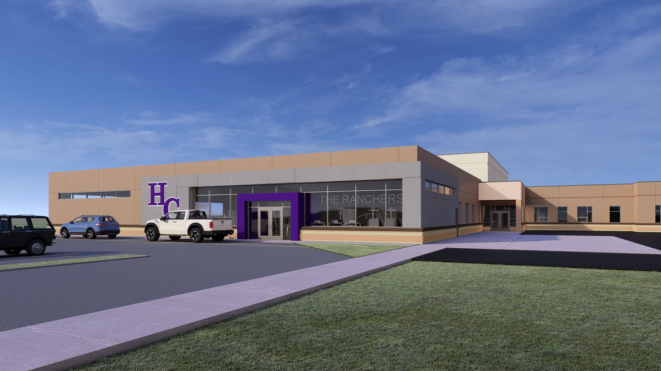
Addition
Concept
Exterior
Rendering
Existing Brick Pattern Full Wrap
CO-OP ARCHITECTURE | Harding County School District

Slide 9
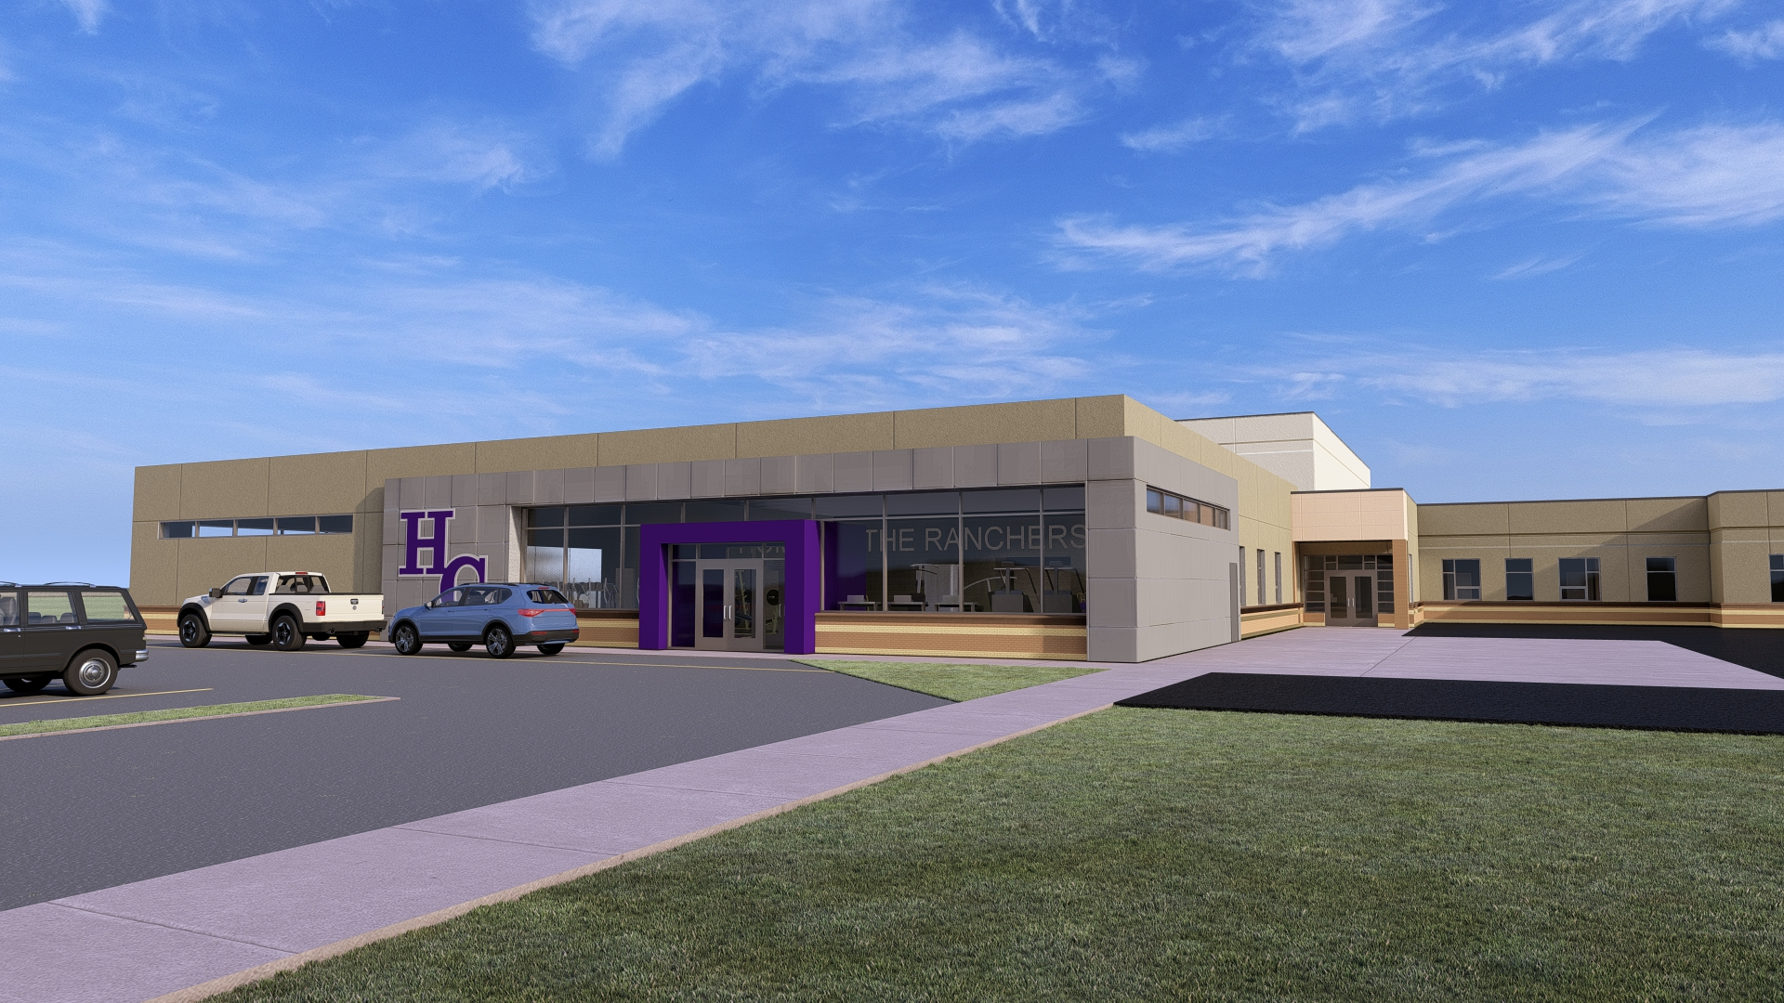
Addition
Concept
Exterior
Rendering
Existing Brick Pattern Glass Coverage
CO-OP ARCHITECTURE | Harding County School District

Slide 10
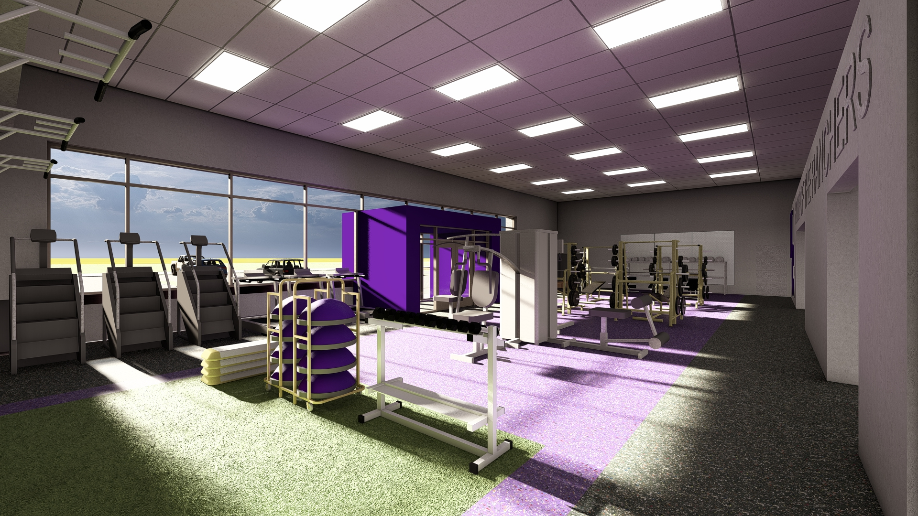
Weight Room
Concept
Interior
Rendering
CO-OP ARCHITECTURE | Harding County School District

Slide 11
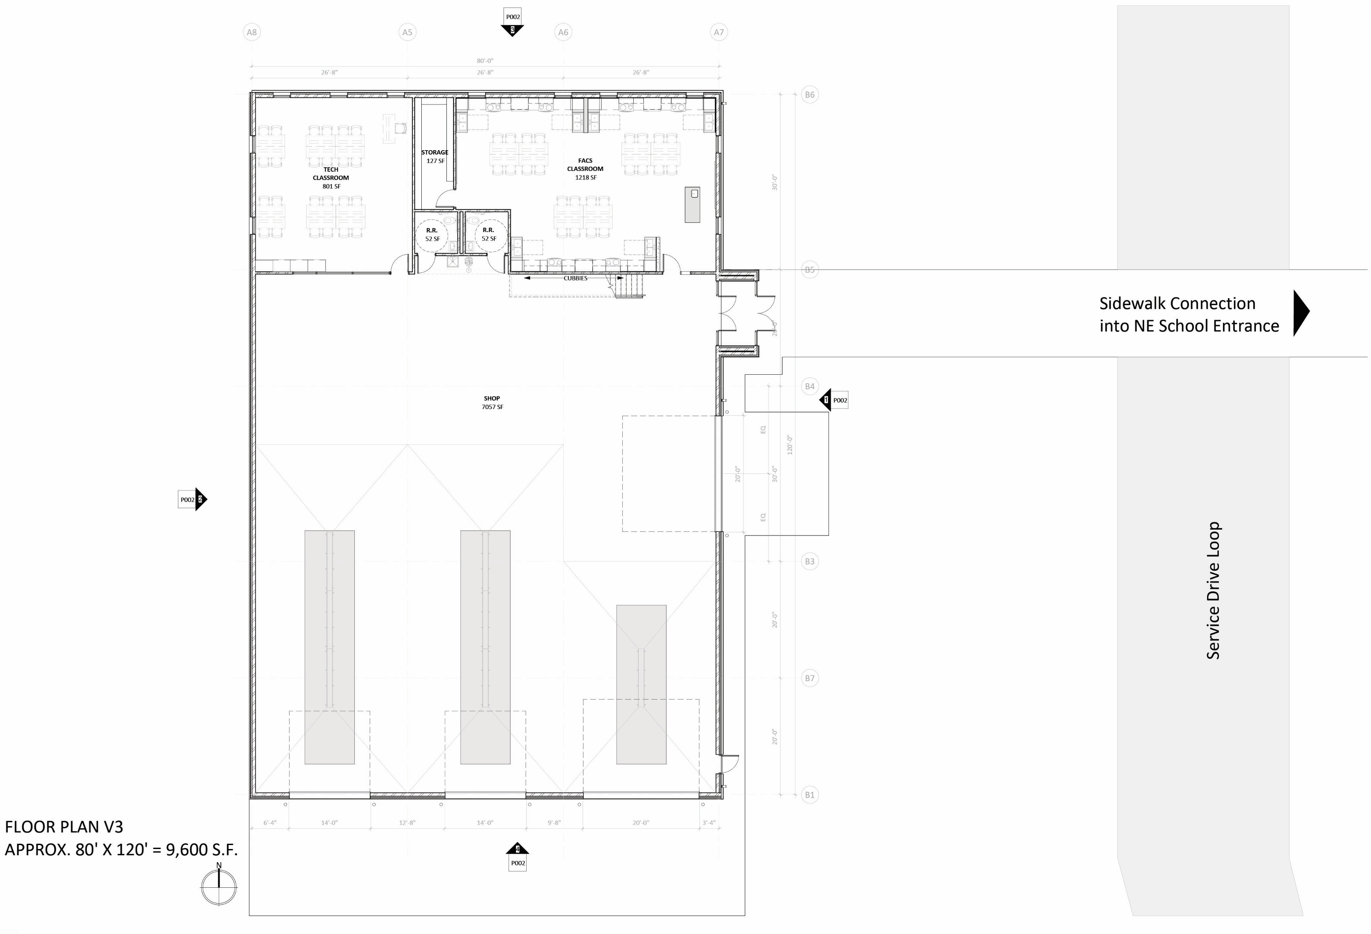
CTE
Building
Addition
Plan
CO-OP ARCHITECTURE | Harding County School District

Slide 12
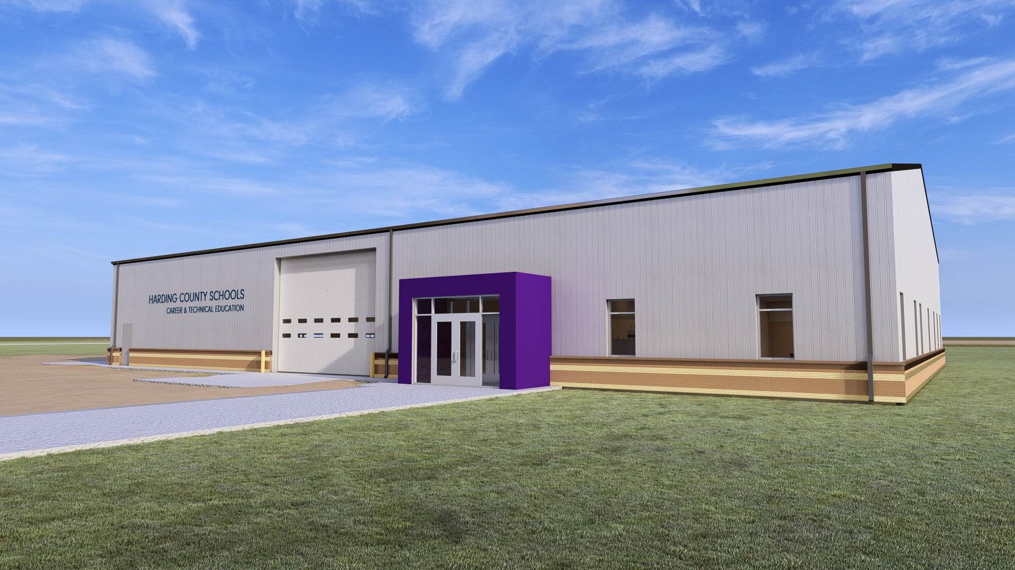
CTE Building
Concept
Exterior
Rendering
CO-OP ARCHITECTURE | Harding County School District

Slide 13
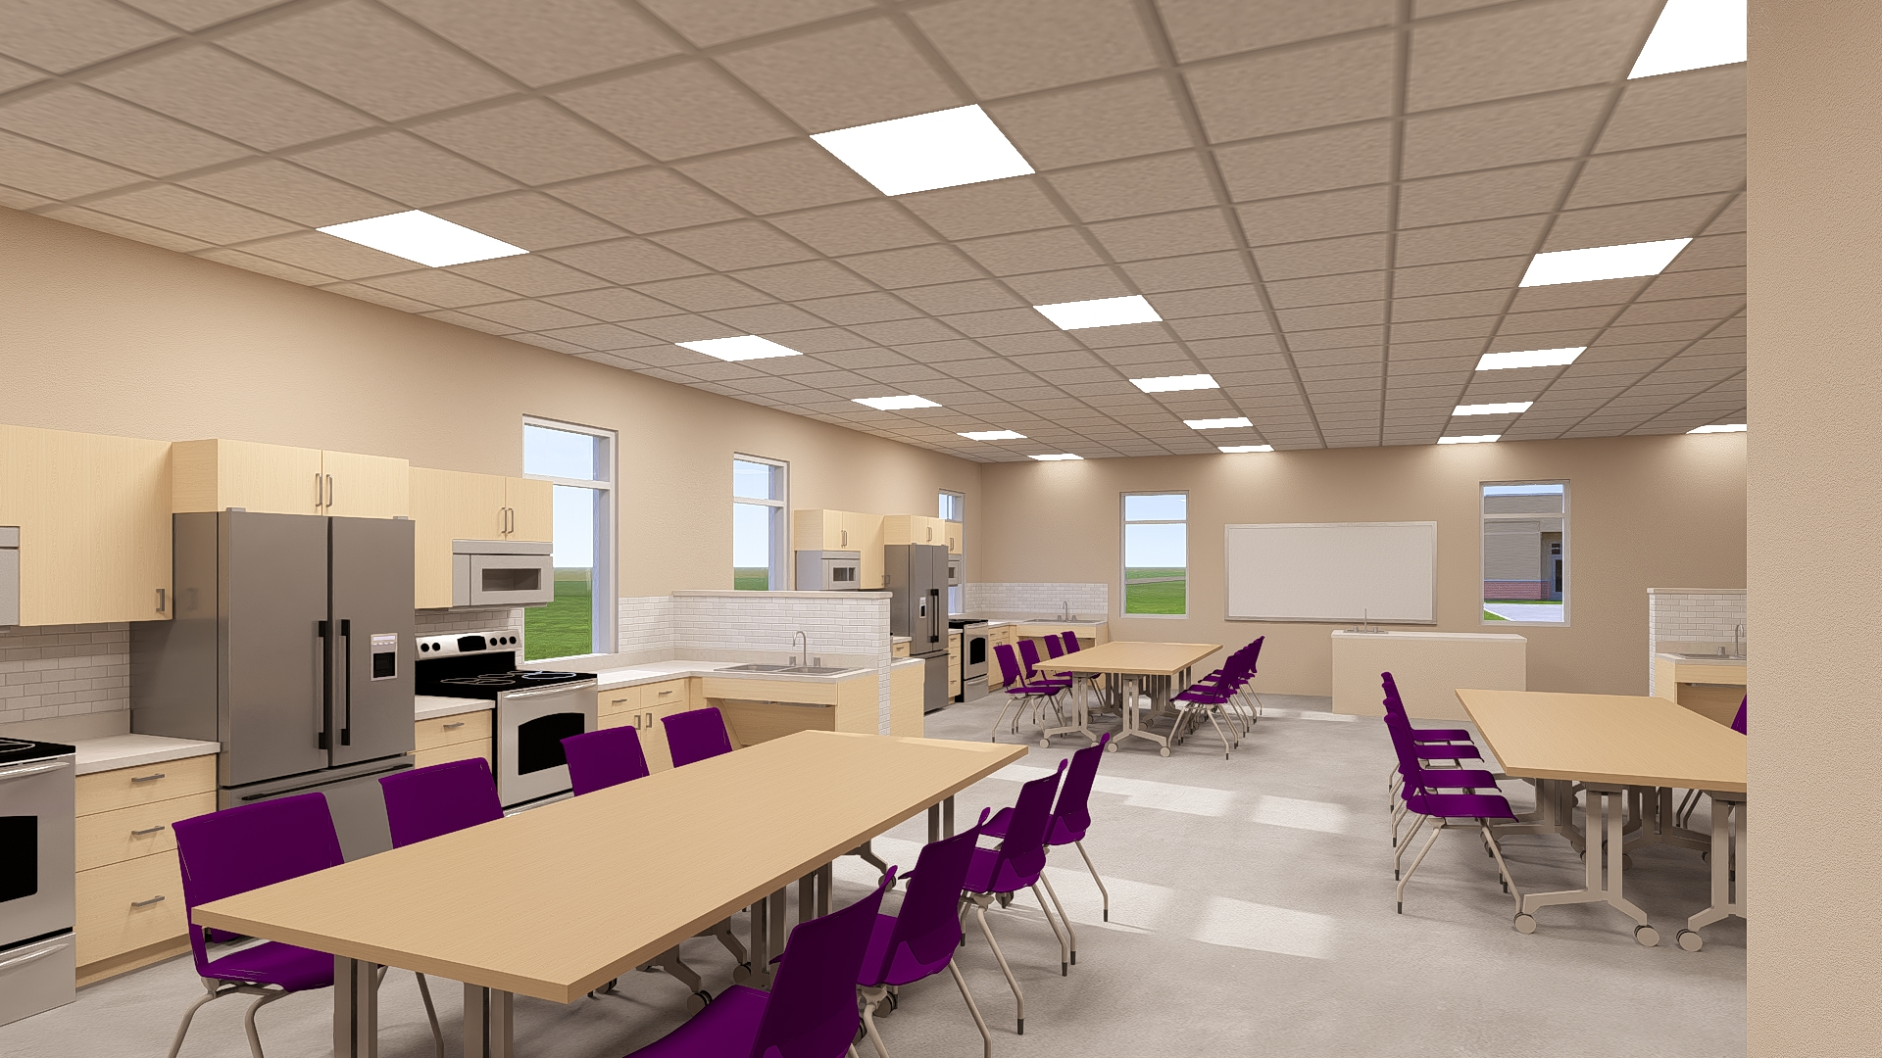
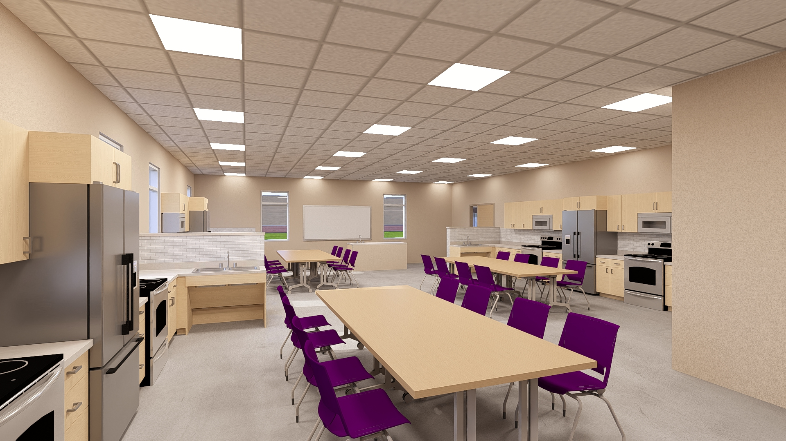
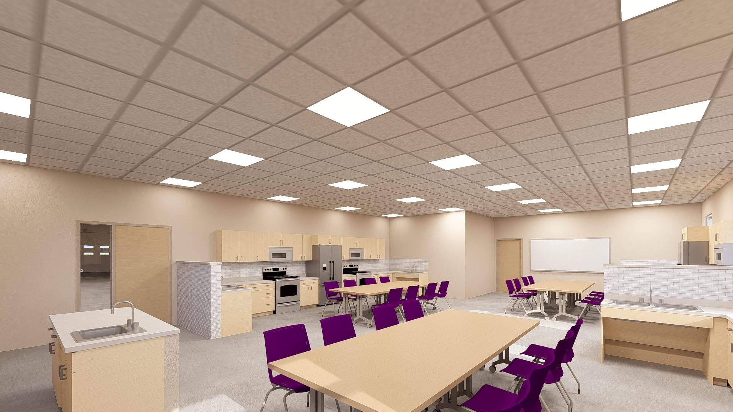
FACS Classroom Concept Interior
Renderings
CO-OP ARCHITECTURE | Harding County School District

Slide 14
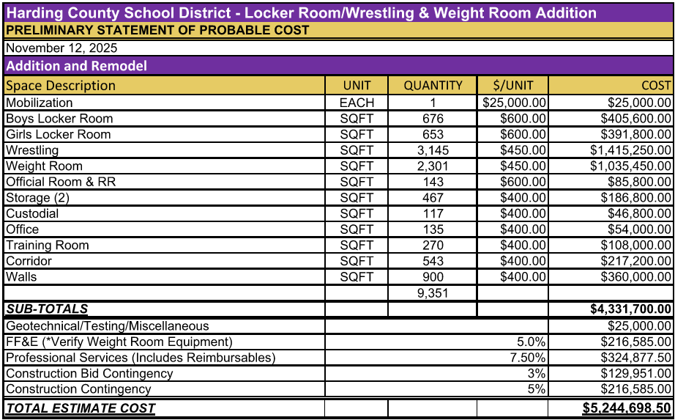
CO-OP ARCHITECTURE | Harding County School District

Slide 15
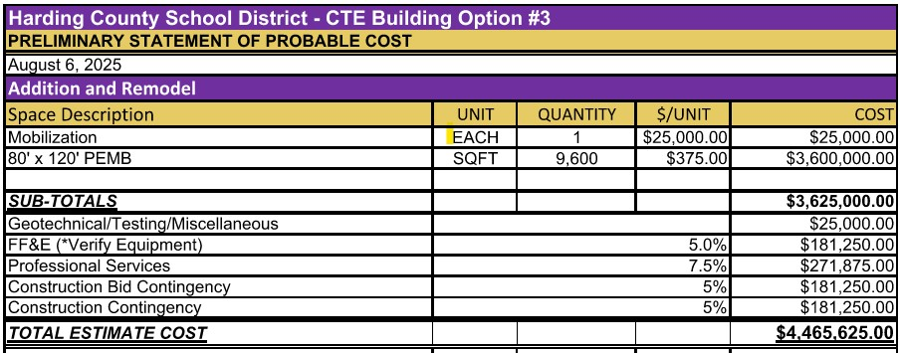
CO-OP ARCHITECTURE | Harding County School District

Slide 16
Sources and Uses
Uses of Funds
Addition / Remodel
$9,280,923
Sources of Funds
Cash on Hand - $1,000,000
Capital Outlay - $2,750,000
GO Bond - $4,600,000
QSCB – 2010 - $930,923
Total - $9,280,923

Slide 17
General Obligation Bond
In 2010 the District passed a GO Bond for $5M
Was a new tax levied on property
All property is classified the same for the levy
Requires a vote
Requires 60% approval

Slide 18
Historic / Projected GO Levy

Slide 20
Capital Outlay Financing
Uses existing funds that the District receives
Not a new tax
The District can afford this new debt service in their budget
The 2010 Capital Outlay will be paid off in 2030, thus allowing the new debt to come on

